Slide 1
Introduction
CS121 Parallel Computing
Fall 2021

Slide 2
Course info
Instructor Assoc Prof Rui FAN 范睿
Research Parallel and distributed computing
Contact fanrui@shanghaitech.edu.cn (English please) 2068-5372
Office hours Thursdays 5-6pm, SIST 1A-504E
Recitation TBA
Website Blackboard and Piazza
Problem sets | 20% | About once every 2 weeks
Labs | 20% | Solve problems using OpenMP and CUDA
Reading project | 15% Teams of 2 | Find an interesting research paper from suggested reading list Tell me your paper by week 8 Submit a report and give a 15 minute presentation in week 16
Course project | 15% Teams of 2 | Find an interesting problem and write an efficient parallel program for it Tell me your problem by week 8 Submit a report and give a 15 minute presentation in week 16
Midterm exam | 10% | At start of week 9
Final exam | 20%
Attendance

Slide 3
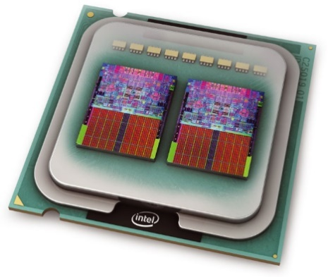
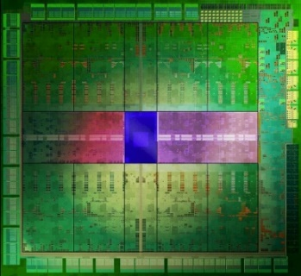
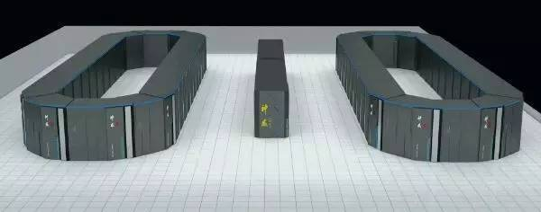
Parallel computing: what and why
Parallel computing studies how to use multiple computers together to solve a problem.
Allows solving complicated problems faster.
Ideally, with k processors we can solve a problem k times faster.
Also more memory to solve larger problems, or same problem with more accuracy.
May be more fault tolerant; but also more prone to faults.
Almost all modern computer systems are parallel.
Multicores, GPUs, cloud computing, etc.
Parallel computing crucial for modern large scale applications, e.g. physical simulations, data mining, machine learning.

Slide 4
Course objectives
To understand the concepts and techniques of parallel computing, and take advantage of the capabilities of modern systems.
Parallel hardware models and interaction with parallel software.
Power and limitations of parallelism.
Efficient parallel algorithms for important problems.

Slide 5
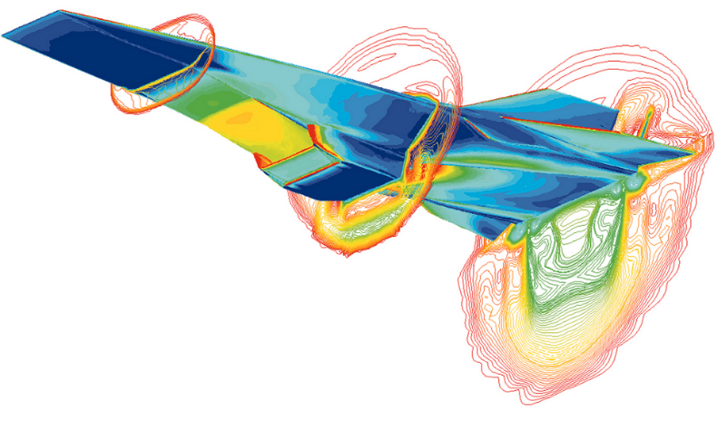
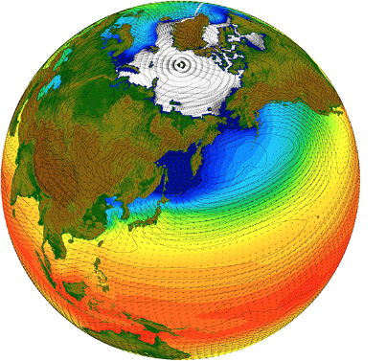
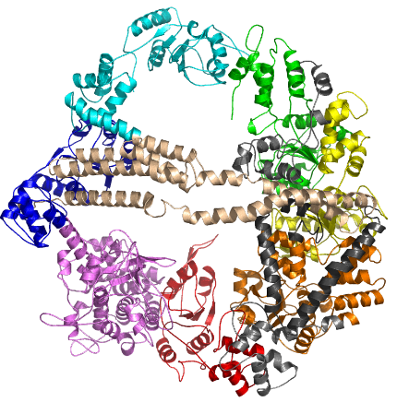
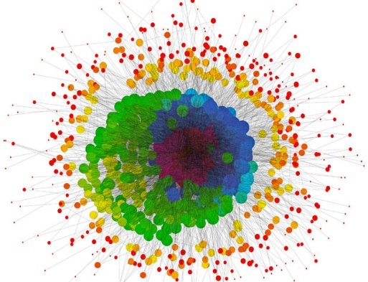
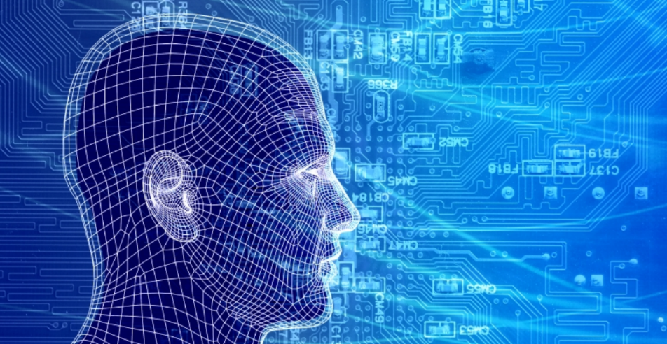
Applications
Fluid dynamics, weather prediction, climate modeling.
DNA, protein, drug structures and interactions.
Quantum / atomic simulations, cosmological simulations.
Cryptoanalysis.
Big data analytics.
Simulating financial and social behaviors.
Machine learning and AI.
Simulating the human brain.

Slide 6
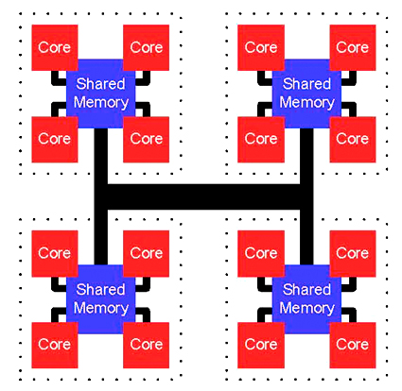
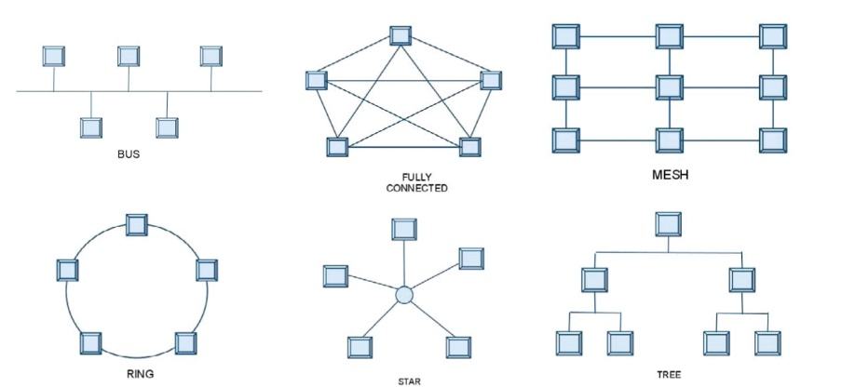
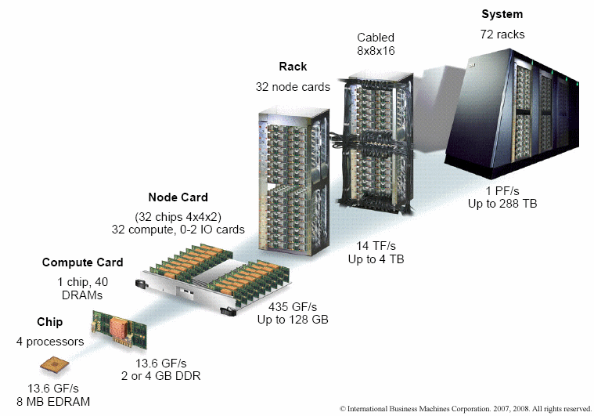
Parallel hardware
Efficient parallel computing requires synergy between parallel hardware and software.
Parallel system consists of multiple independent processors communicating over an interconnect.
Unlike sequential (von Neumann) architecture, many parallel hardware designs.
Different types of processors (multicores, manycores, FPGA, etc.).
Heterogeneous designs combine multiple architectures, e.g. multicores and GPUs.
Different interconnect designs.
Communicate through shared memory, or message passing over network.
Parallelism exists at many layers.
Instruction, core, chip, node, rack, etc.

Slide 7
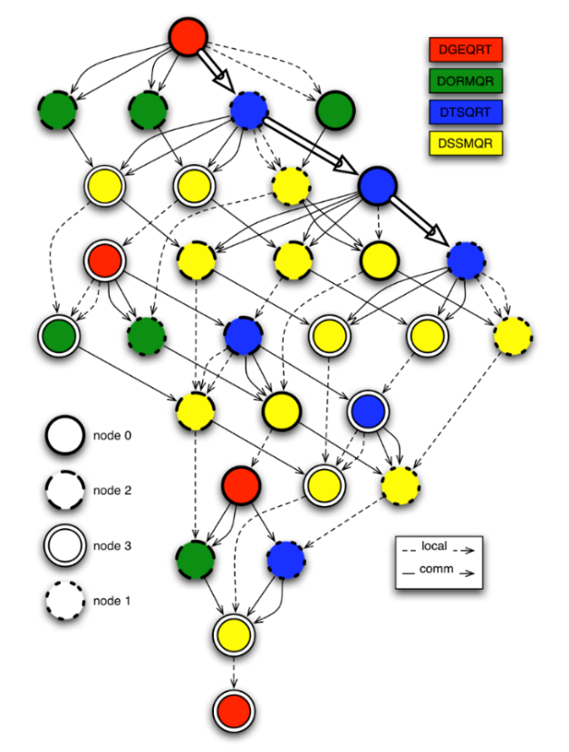
Parallel software
Break a large problem into subproblems (tasks) that can be solved (somewhat) independently.
OS and scheduler allocate tasks to different processors.
Respect dependencies between tasks.
Parallel software must be matched to the hardware.
Similar amounts of concurrency in software and hardware.
Hardware must adequately handle software communication pattern.
No single hardware model suffices.
Parallel software is often not portable.
PRAM model tries to abstract parallel hardware.
Useful for understanding inherent parallelism.
Unrealistically discounts cost of communication.

Slide 8
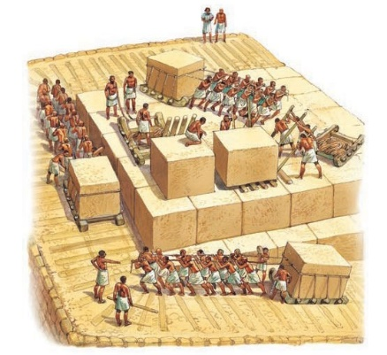

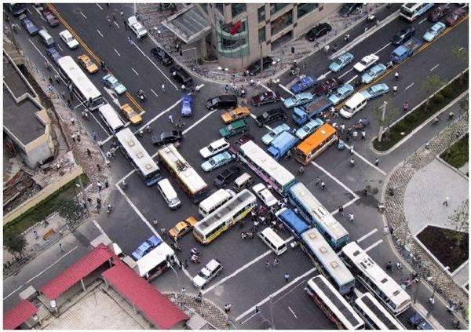
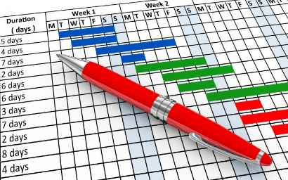
Challenges
Harnessing power of the masses.
Easier said than done...
Communication
Processors compute faster than they can communicate.
Problem gets worse as number of processors increases.
Main bottleneck to parallel computing.
Synchronization
Tasks may interfere with each other, so can’t be done at same time.
Scheduling
Track and enforce dependencies.
Find good allocation of tasks to processors.
Data locality, heterogeneous processors
Maximize utilization and performance.

Slide 9
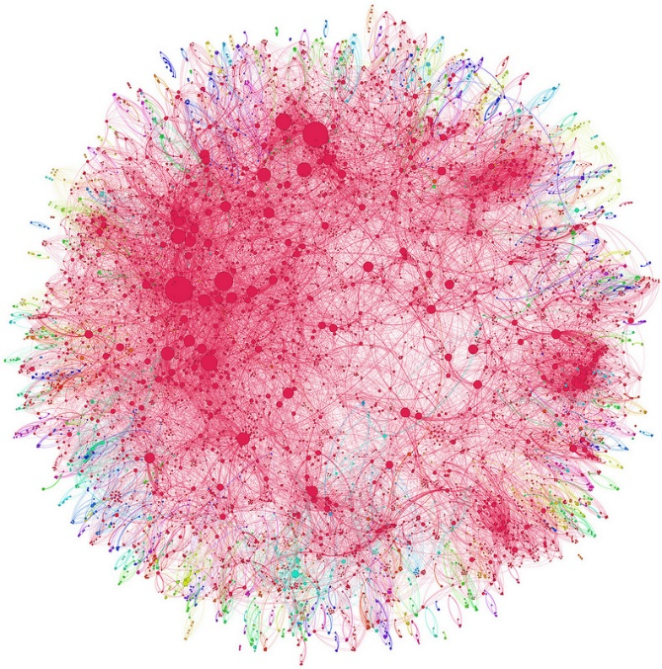


Challenges
Structured vs unstructured
Structured problems can be solved with custom hardware.
Unstructured problems more general, but less efficient.
Inherent limitations
Some problems are not (or don’t seem to be) parallelizable.
Ex Binary search, Dijkstra’s shortest paths algorithm.
Other problems require clever algorithms to become parallel.
Ex Fibonacci series (a_{n} = a_{n-1} + a_{n-2}).
The human factor
Hard to keep track of concurrent events and dependencies.
Parallel algorithms are hard(er) to design and debug.

Slide 10
Course outline
Parallel architectures
Shared memory
Distributed memory
Manycore
Parallel languages
OpenMP, MPI, CUDA, MapReduce
Algorithm design techniques
Decomposition, load balancing, scheduling
Parallel algorithms
Dense and sparse matrix algorithms, sorting, search, graph algorithms, PRAM algorithms, etc.

Slide 11
A brief history
Research and theory started in the early 60’s.
Cray-1 reached 160 MFLOPS in 1976.
Commercially successful supercomputers (Cray, Thinking Machines, etc.) started in 1980’s.
Used expensive custom processors.
In 1990’s massively parallel processors (MPPs) and clusters became dominant.
MPPs use commercial (OTS) processors with custom interconnects.
Clusters use OTS processors and interconnects running Linux.
Cheap, easy to build and relatively powerful.
Most data centers today are clusters.
Fastest supercomputer today is Fujitsu Fugaku MPP.
Runs at 442 PFLOPS, about 3M times faster than a workstation.
Apart from supercomputers, progress in parallel computing stalled in 1990’s until mid 2000’s.

Slide 12
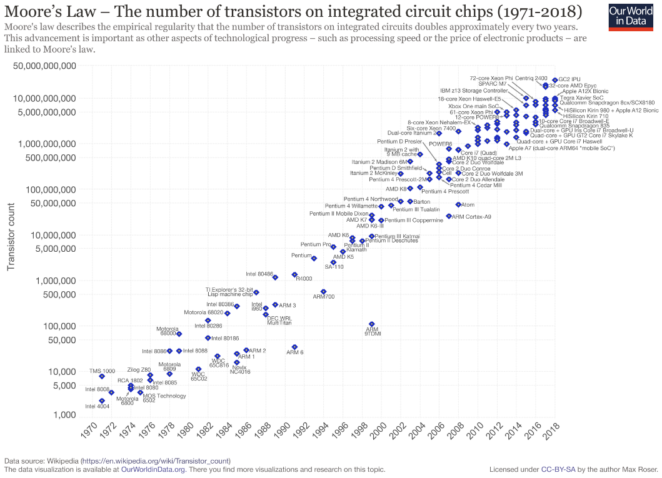
Moore’s Law and parallel computing
In 1965, Gordon Moore, co-founder of Intel, predicted transistor count would double every 18 months.
Held true for the last 50 years!
Until mid 2000’s, this implied single processor performance doubled at same rate.
This held back development of parallel computers, since in the time to develop one, single processor performance would improve dramatically.
But since ca. 2005, parallel processing has become essential to taking advantage of Moore’s Law.

Slide 13
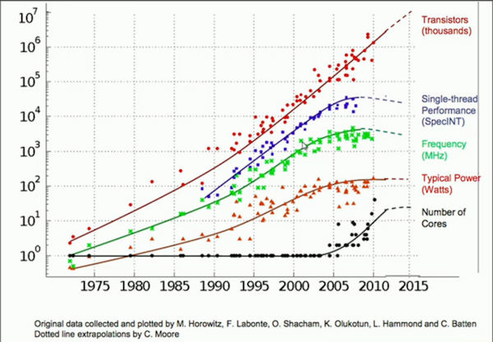
Moore’s Law and performance
Transistor properties, e.g. size and clock speed, do not scale equally.
Higher single processor clock speeds is increasingly difficult to achieve.
Heat
Power consumption
Current leakage

Slide 14
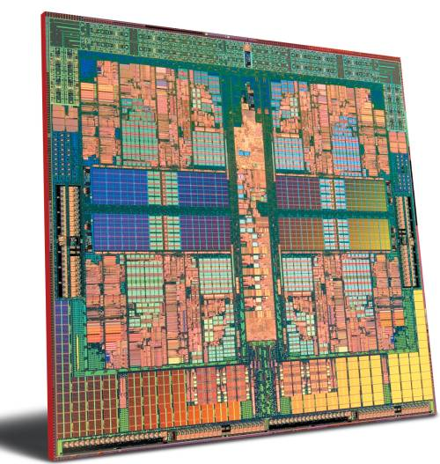
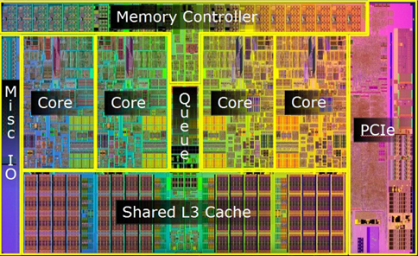
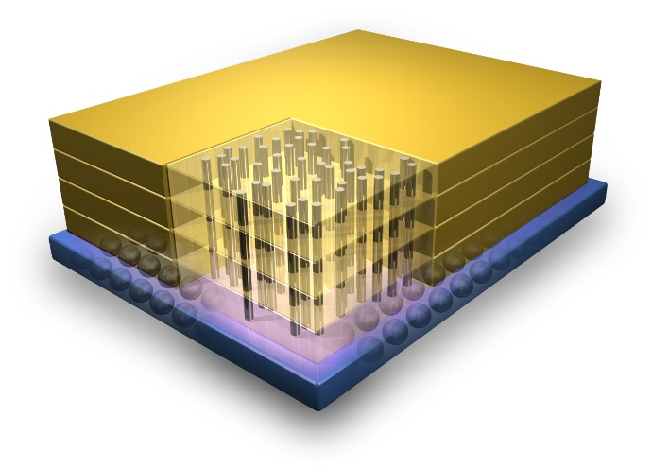
Moore’s Law revisited
Multicore technology addresses (lack of) clock speed scaling.
Link multiple processing cores together on same chip.
More efficient to replace a single high speed processor with multiple slower processors.
Another approach is to stack chips in a 3D structure.
Developing software for multicores has been harder than scaling hardware.
Software developers with parallel computing skills are in high demand.

Slide 15
The state of the art
Parallel computers today mainly based on four processor architectures.
Multicores
Small / moderate number (≤ 64) of fast, general purpose cores.
Ex Intel Xeon, IBM Power, Sun SPARC.
Manycores
Large number (1000’s) of simple cores.
Ex Nvidia Pascal GPU, Intel Xeon Phi, Sunway SW26010.
FPGA (field programmable gate arrays)
Reconfigurable hardware customized for specific problems.
ASIC (application specific integrated circuits)
Specially built hardware for specific problems.
Ex Google TPU, Apple Neural Engine, IBM TrueNorth.
In addition to processing speed, energy efficiency also increasing important.
Biggest datacenters consume over 100 MW of power, ~ 50K homes.
Biggest supercomputers consume ~ 20MW of power.
Goal is a supercomputer achieving 50 GFLOPS / W.
Current supercomputers achieve 1-6 GFLOPS / W.

Slide 16
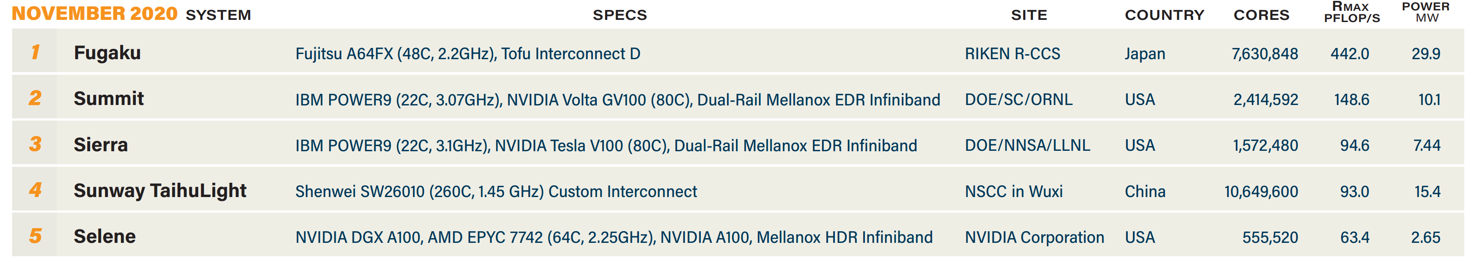
Top 500 list
Biannual ranking of fastest 500 supercomputers in the world.
Speed measured in floating point operations per second.
Uses high-performance LINPACK to solve a dense linear system Ax = b.
Compute intensive, but doesn’t stress memory system.
May not represent performance on real-world problems.
For comparison, Intel multicore achieves ~50 GFLOPS / core, and GPU achieves ~ 10 TFLOPS / board.
Mega | Giga | Tera | Peta | Exa
10⁶ | 10⁹ | 10¹² | 10¹⁵ | 10¹⁸

Slide 17
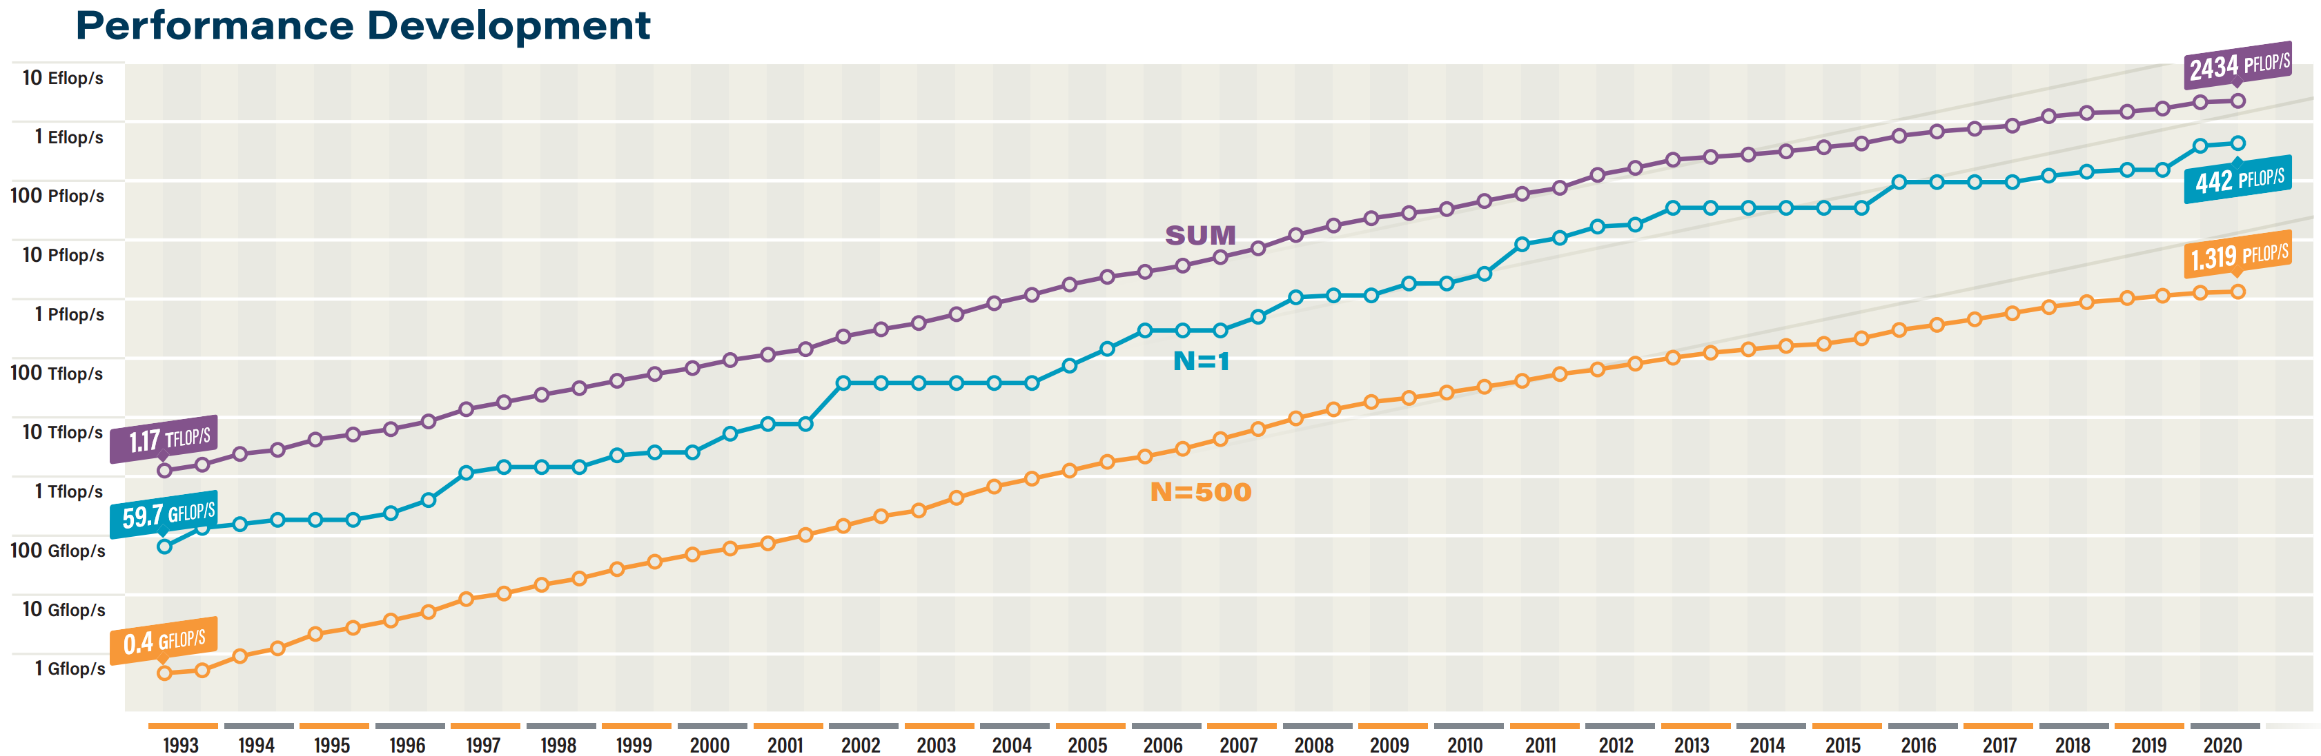
Top 500 – Trends

Slide 18
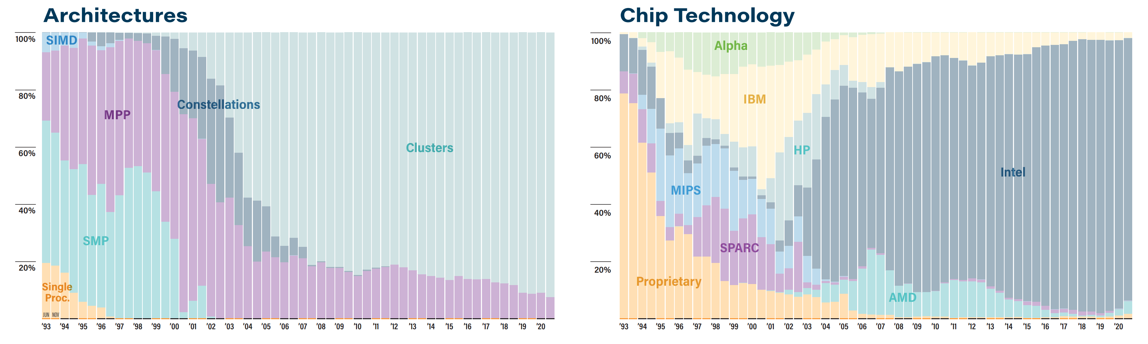
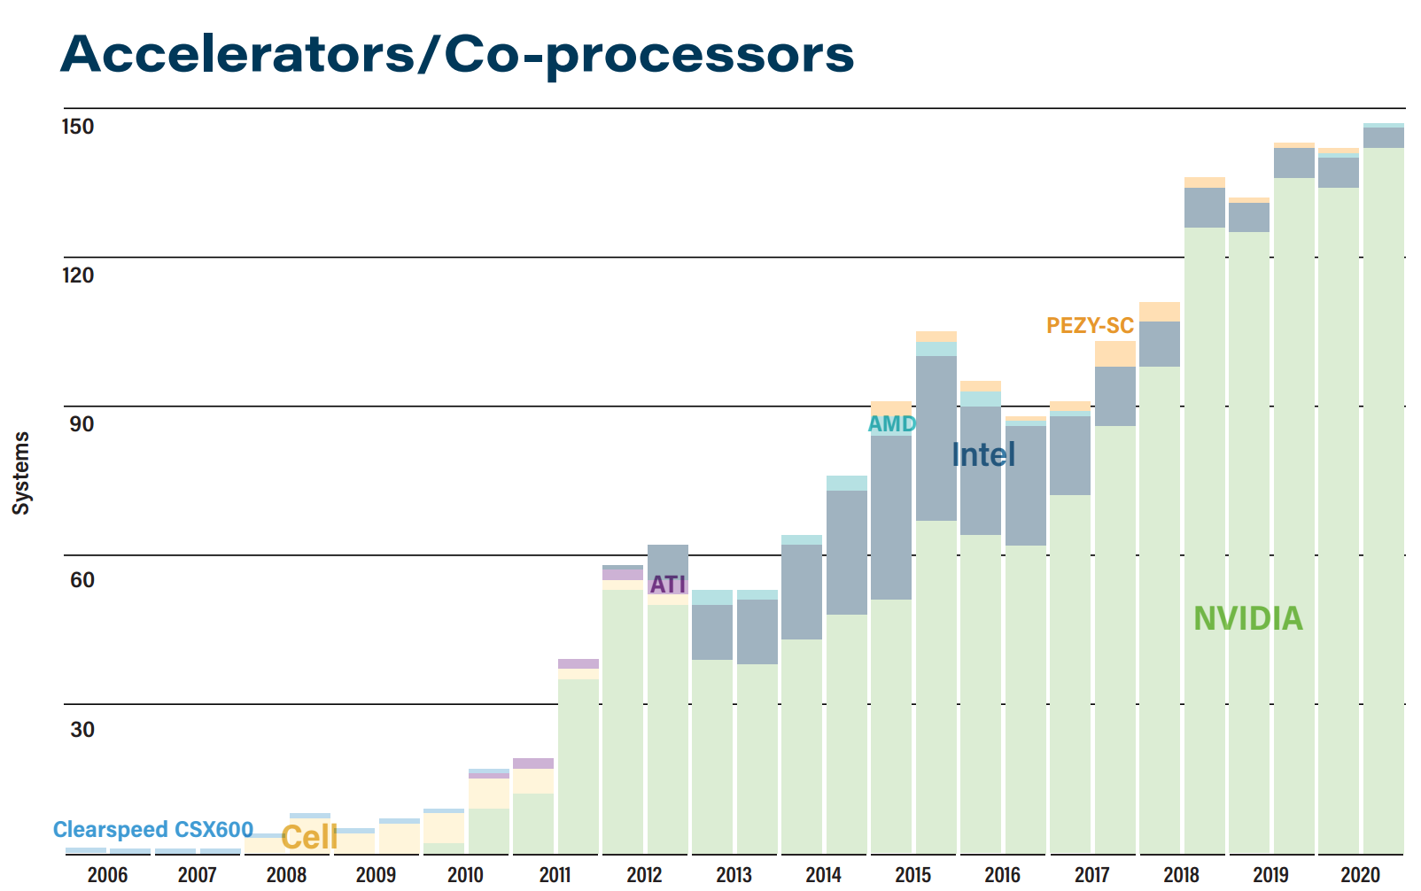
Top 500 – Architecture

Slide 19
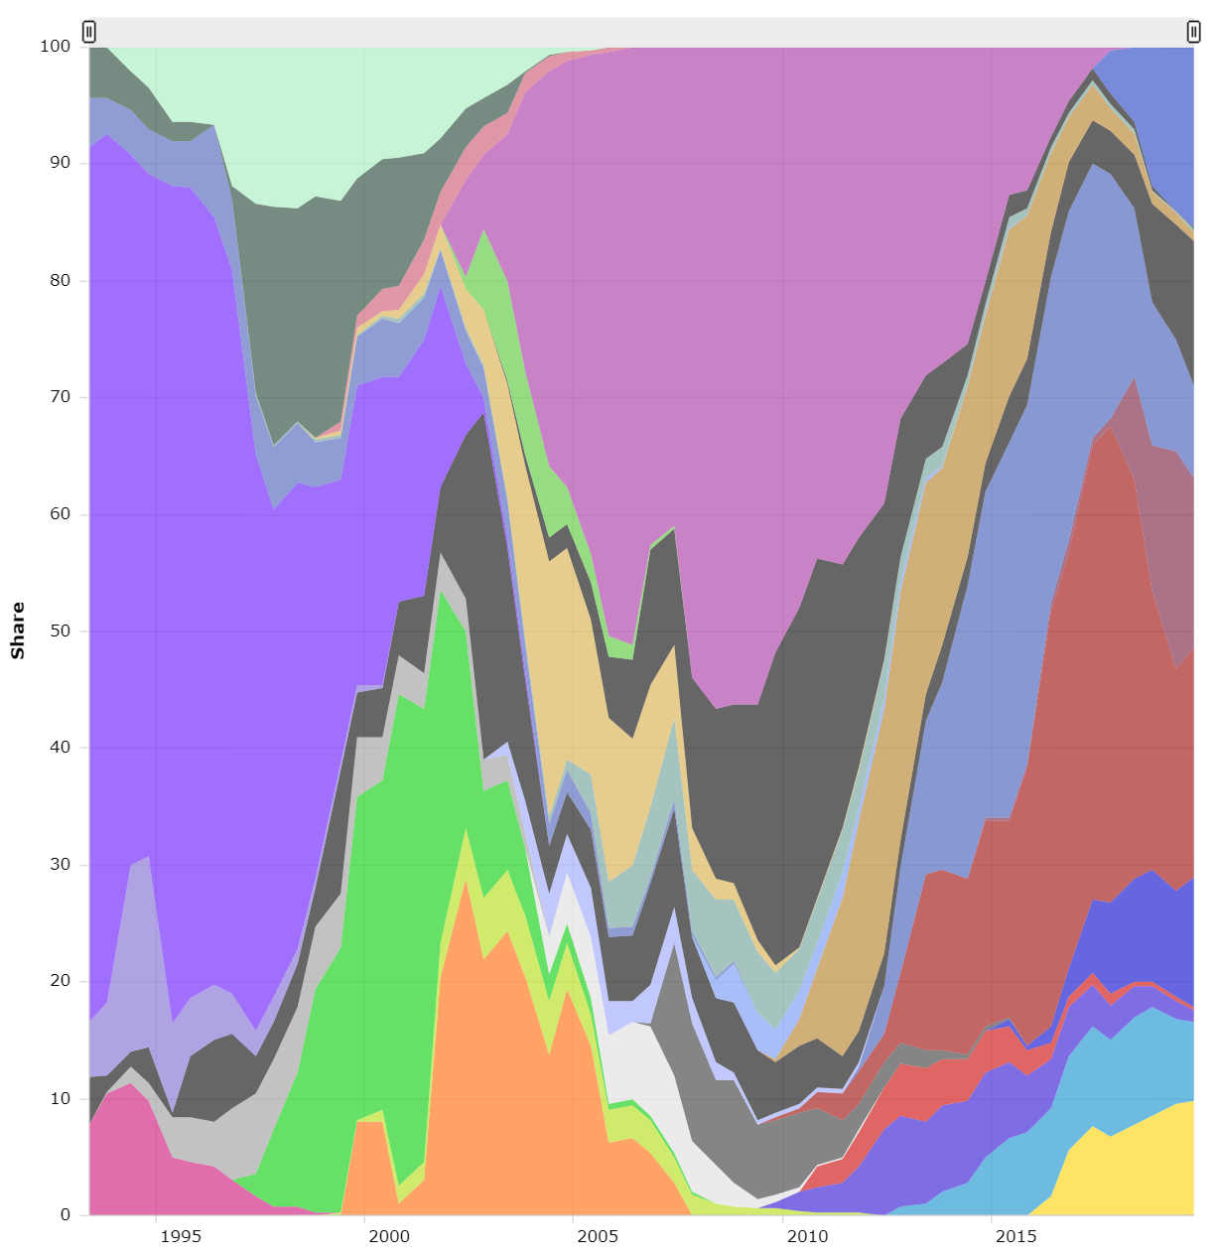
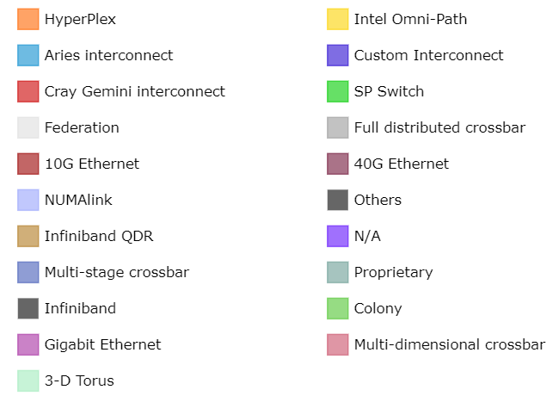
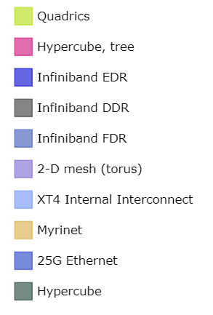
Top 500 – Interconnect

Slide 20
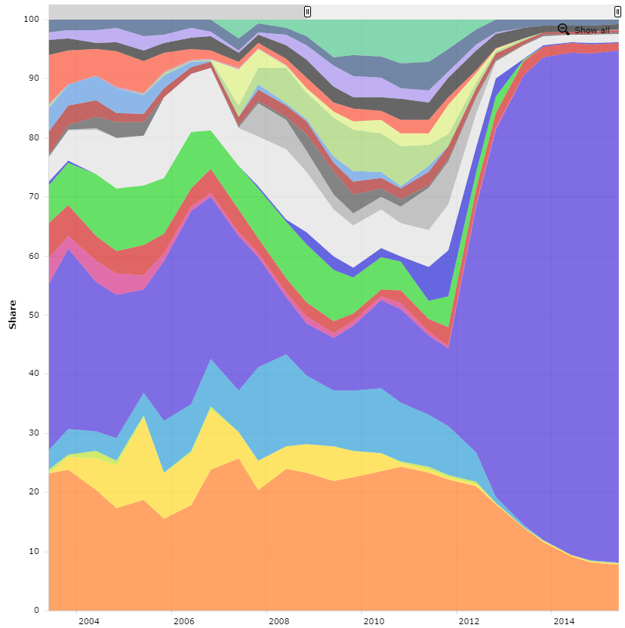
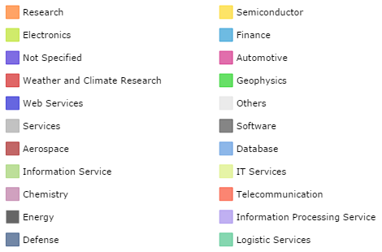
Top 500 – Applications

Slide 21
Other performance measures
LINPACK does compute-intensive operations on structured dense matrices.
Uniform control flow, predictable and coalesced memory accesses.
Ideal for physical simulations.
Data-intensive applications today have instruction divergence, branching and random memory accesses.
New benchmarks give more complete performance picture
HPCG performs sparse matrix operations.
Graph500 performs breadth-first search.
A computer’s performance can differ dramatically depending on benchmark.

Slide 22
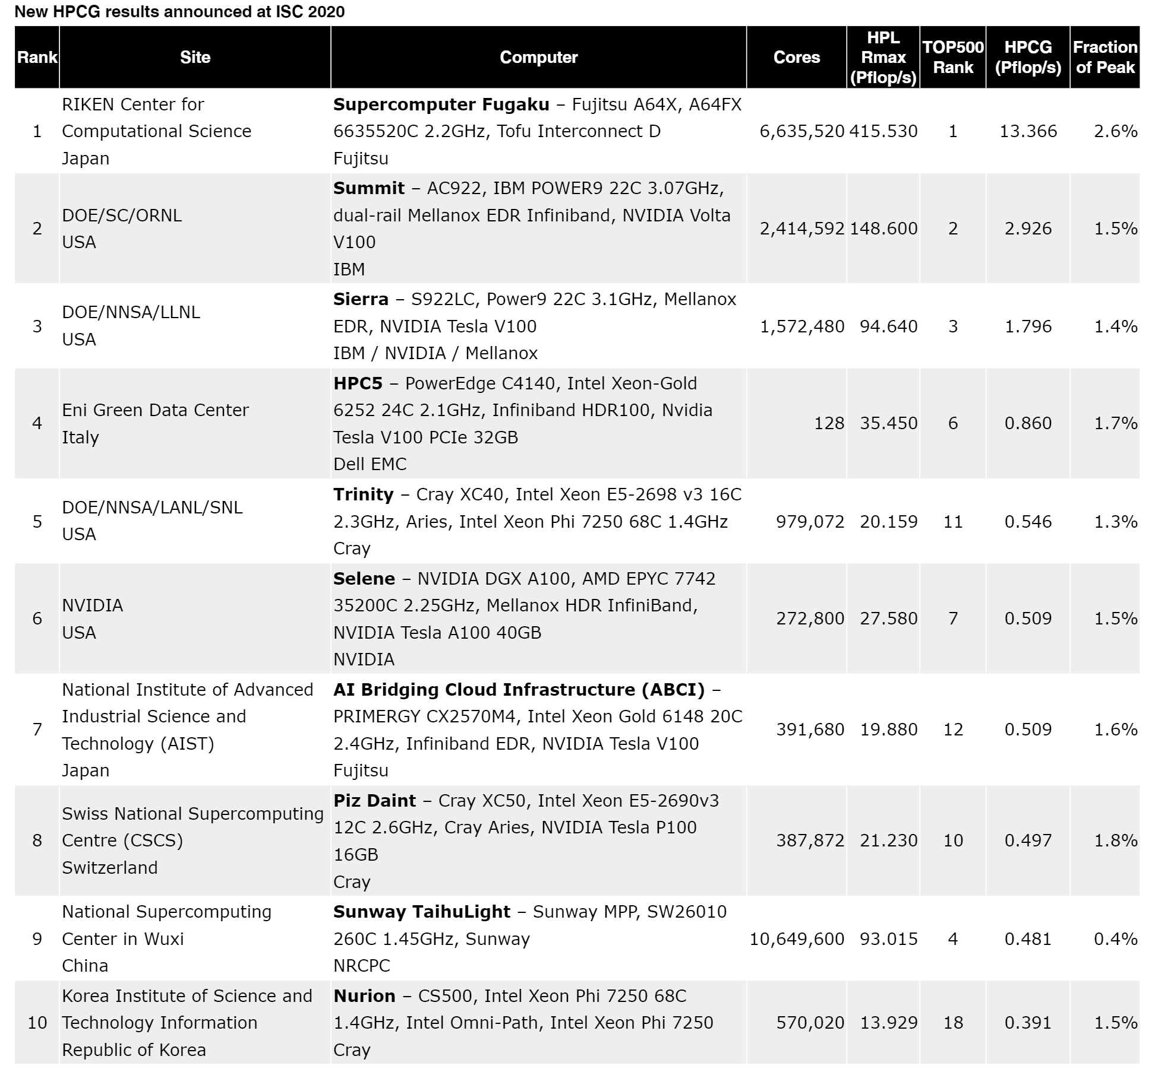
HPCG

Slide 23
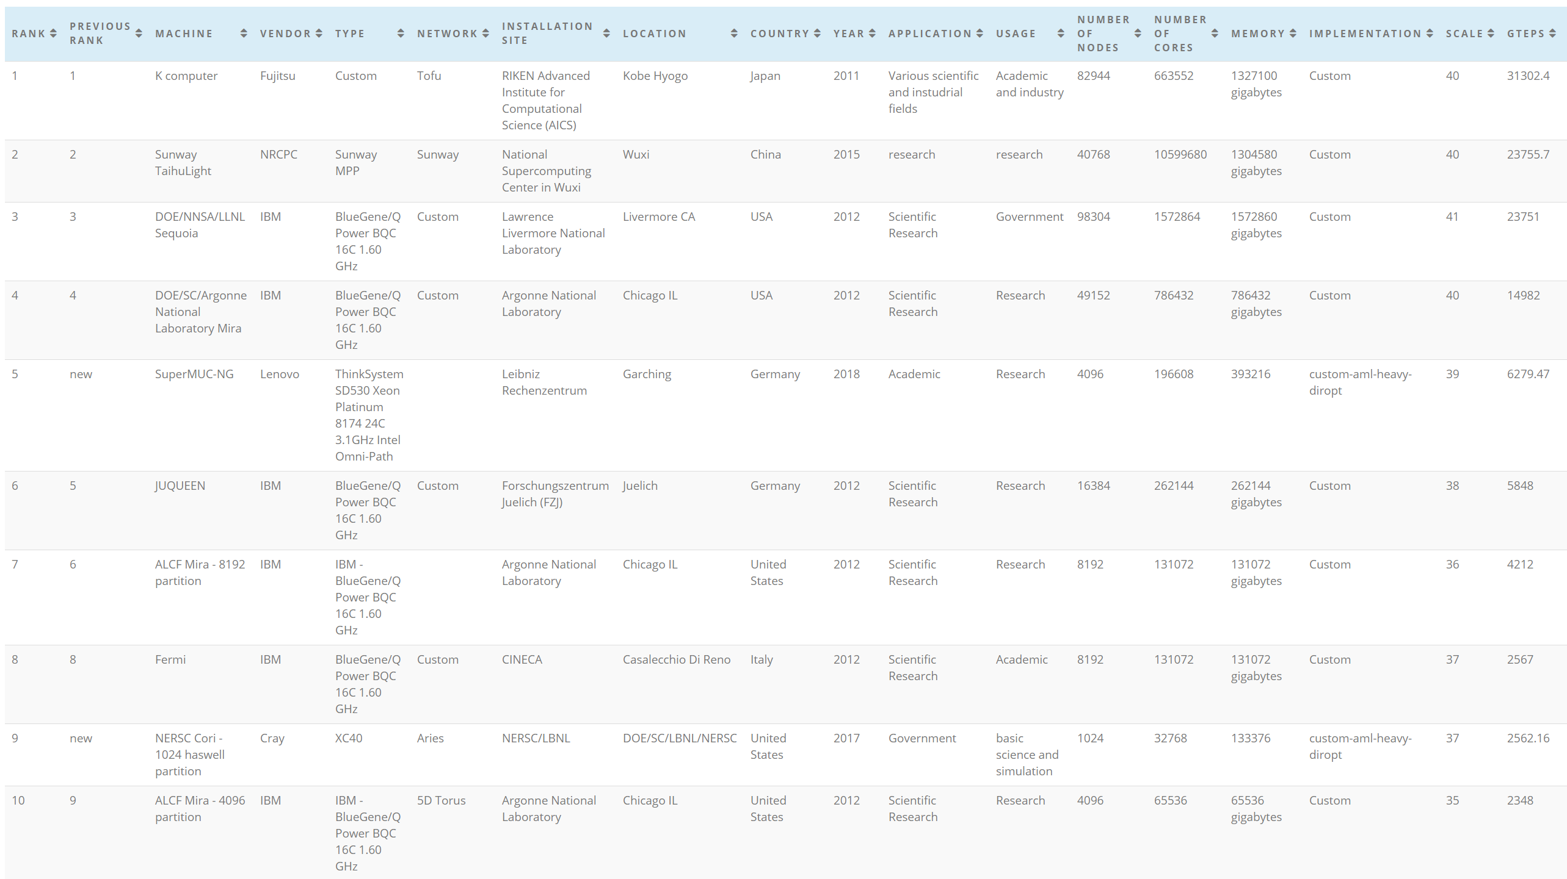
Graph500

Slide 24
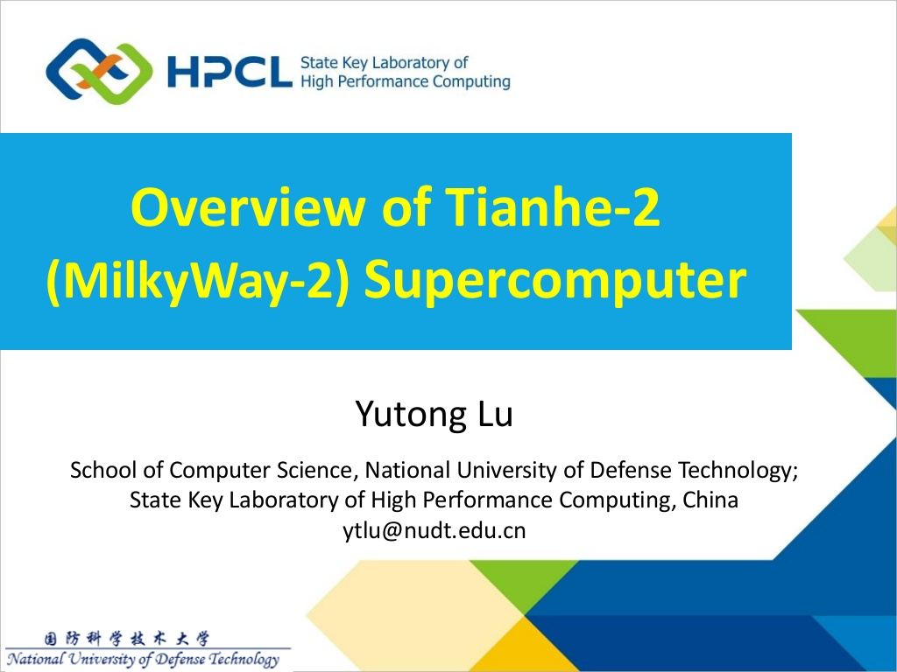

Slide 25
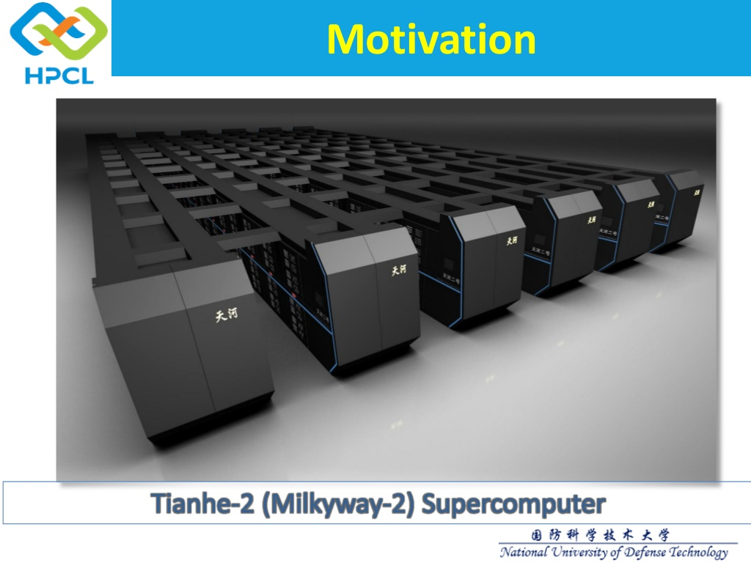

Slide 26
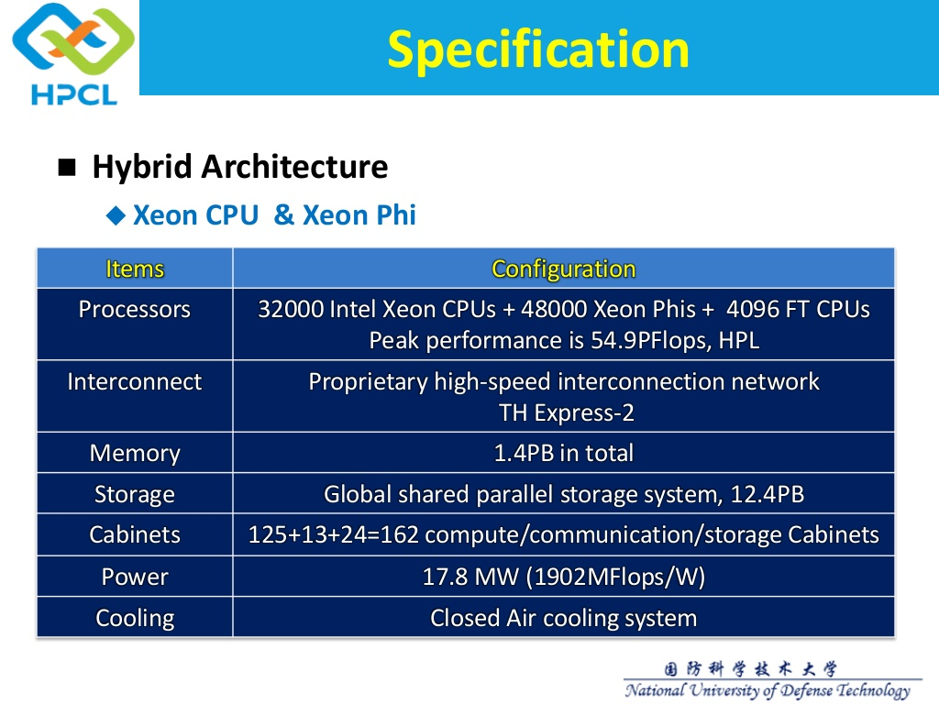

Slide 27
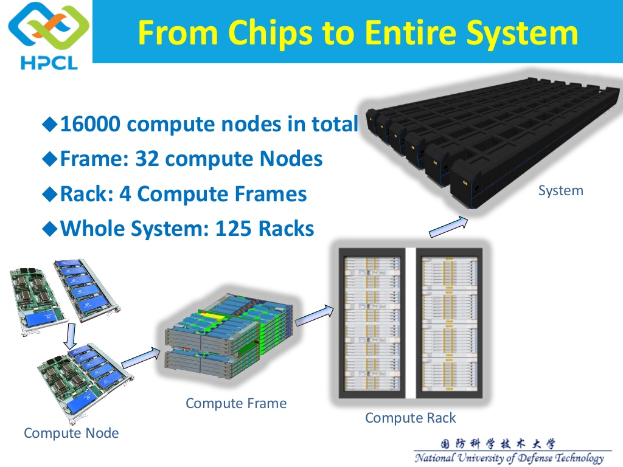

Slide 28
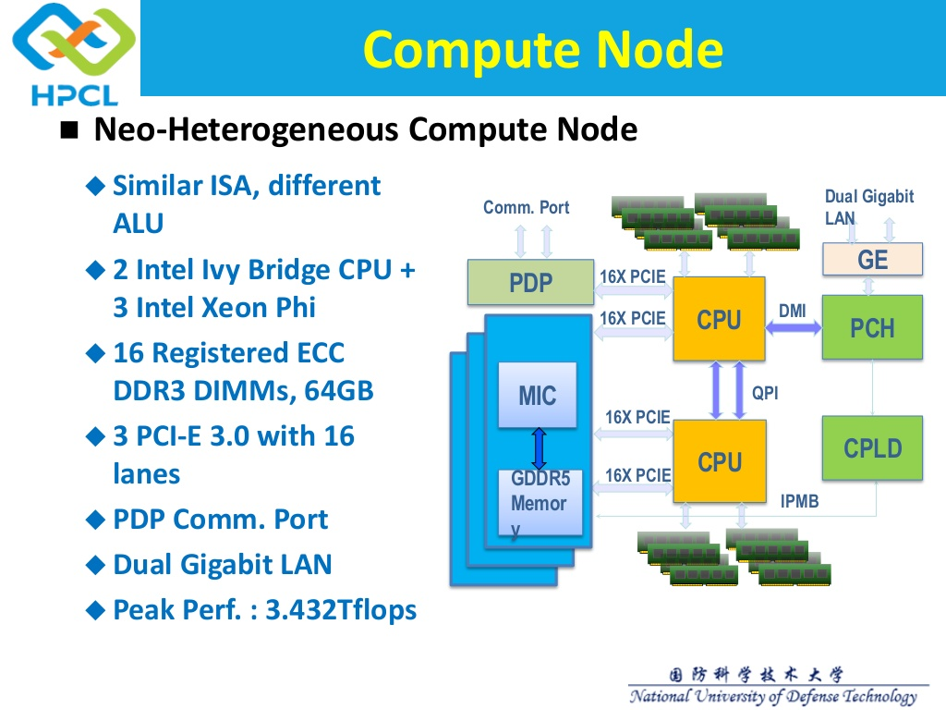

Slide 29
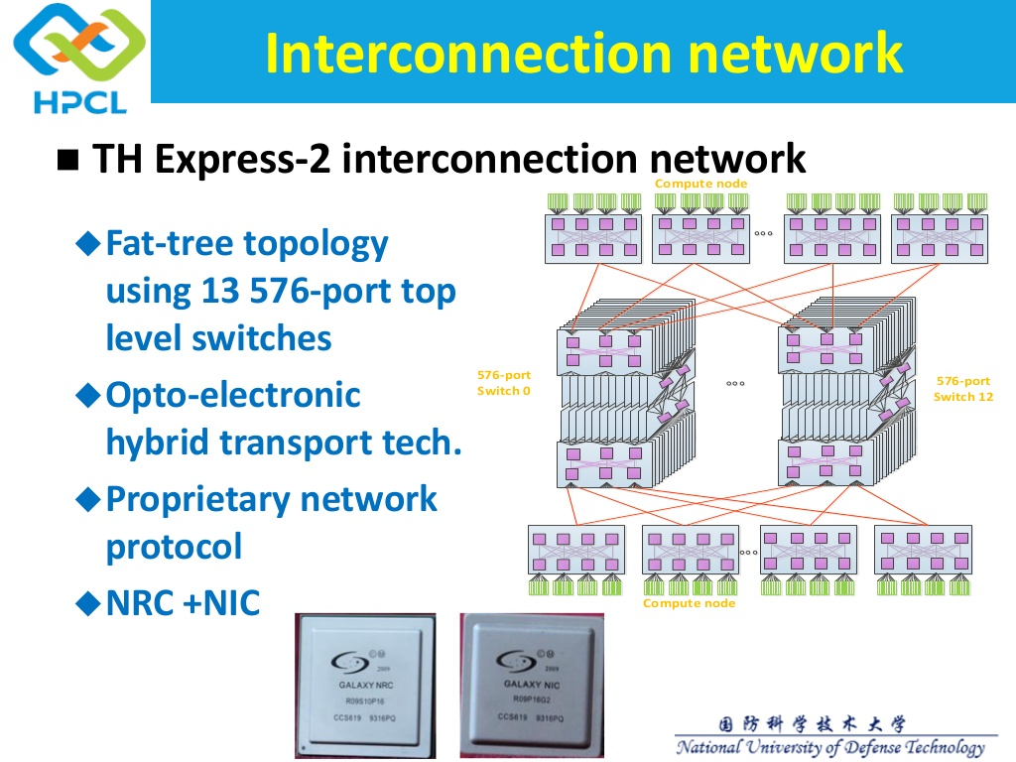

Slide 30
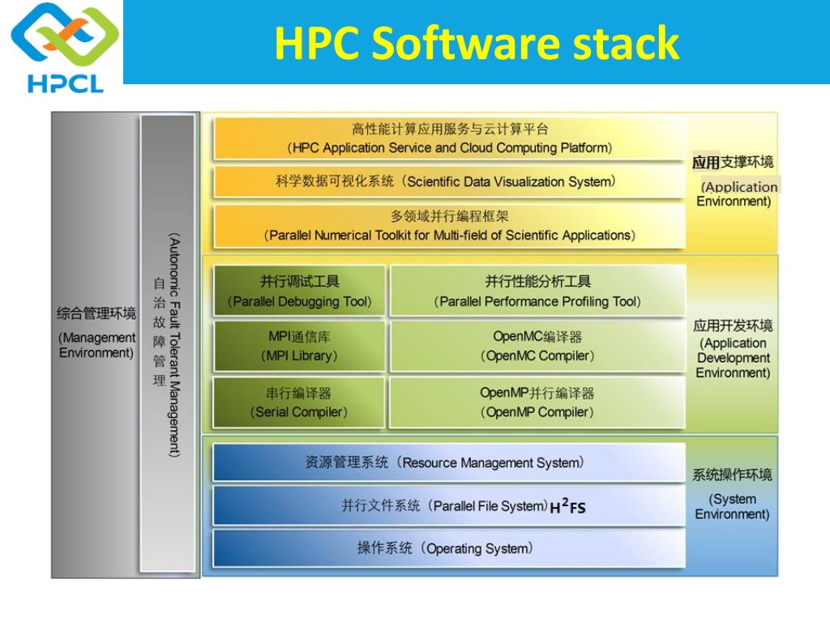

Slide 31
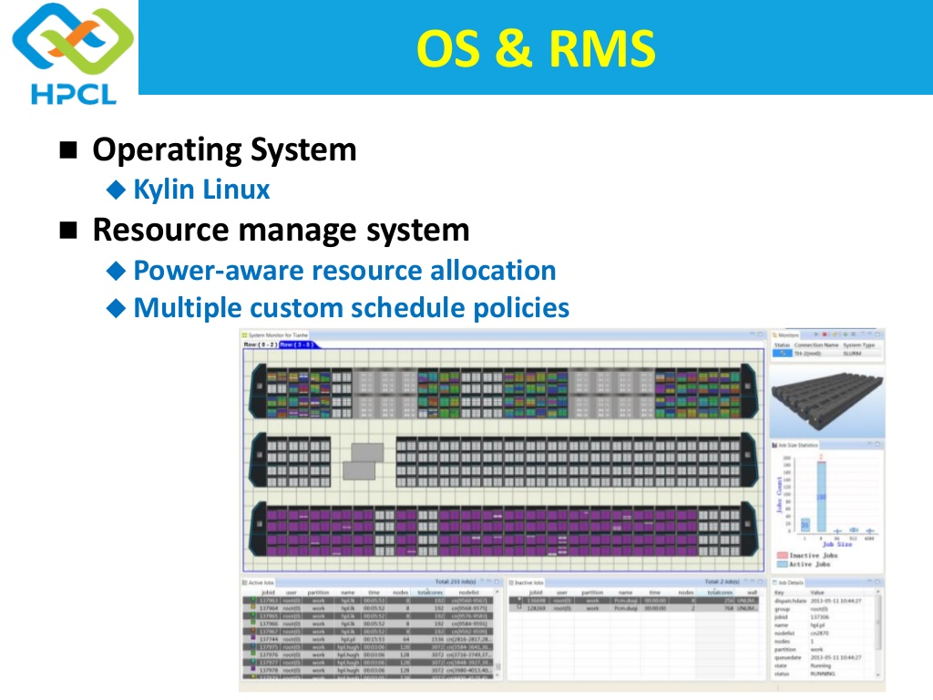

Slide 32
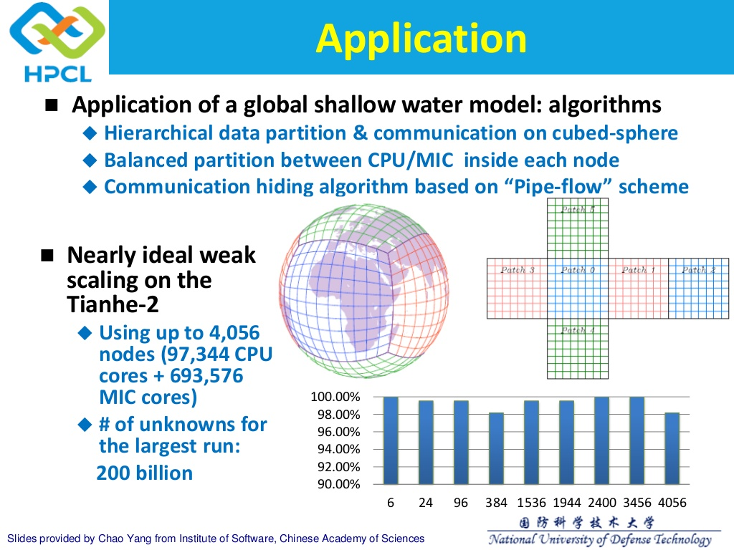

Slide 33
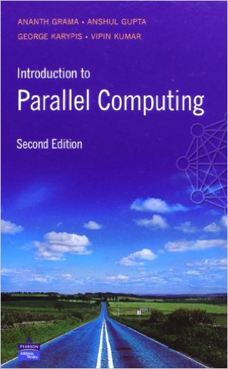
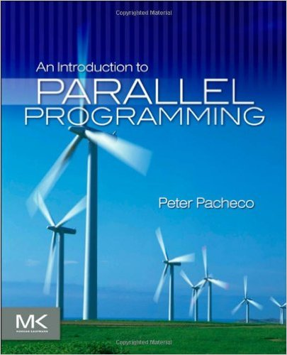
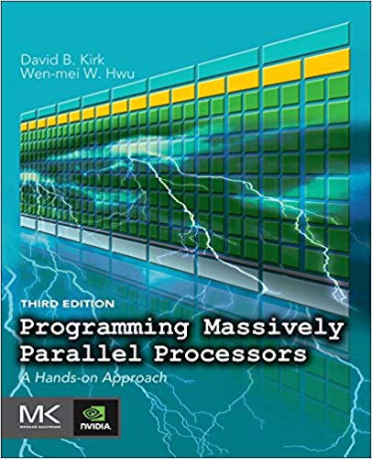
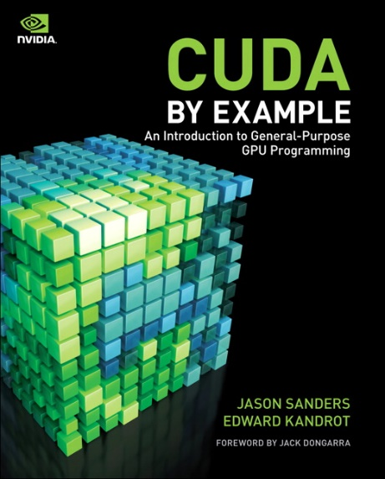
Course texts
Course materials partly taken from the following texts.
But all topics covered by lecture slides.
Introduction to Parallel Computing. Grama, Karypis, Kumar, Gupta. Pearson, 2003.
An Introduction to Parallel Programming. Peter Pacheco. Morgan Kaufmann 2011.
Programming Massively Parallel Processors. Kirk, Hwu. Morgan Kaufmann 2016.
CUDA by Example. Sanders, Kandrot. Addison-Wesley 2010.

